Slide 1
APCC One-Day School Visit Program
⓪
in（学校名） Elementary School
July 16th(TUE), 2024
写真提供：福岡市

Slide 2
Welcome to （学校名） Elementary School
①

Slide 3
②
Our School
このスライドに
学校の写真を貼ってください

Slide 4
③
Our School
・Established ・・・・・・・1900
・Students ・・・・・・・・・ 500
・Principal ・・・・・
Mr. Taro Asia

Slide 5
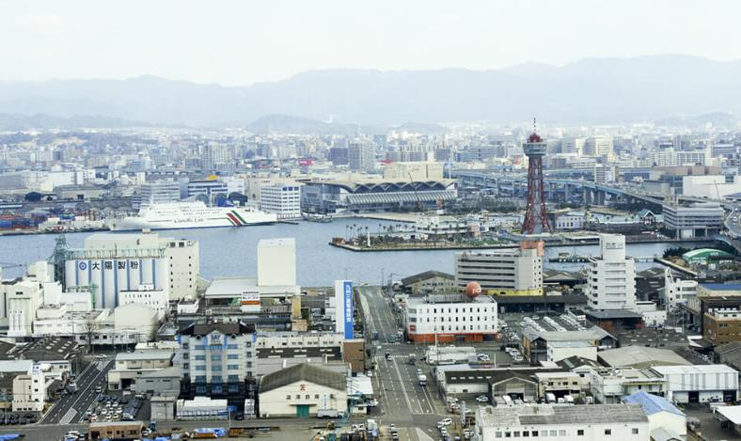
④
Fukuoka City

Slide 6
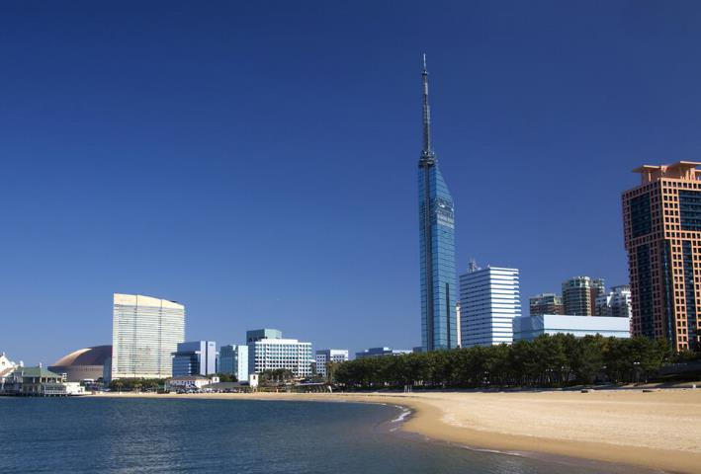
⑤
Fukuoka City

Slide 7
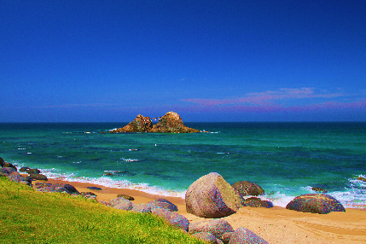
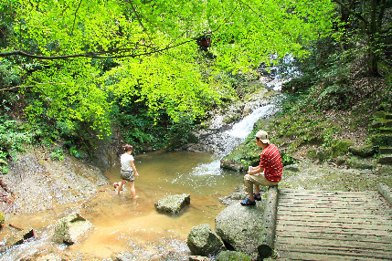
⑥
Environment
Beautiful
beaches
mountains
and
nature

Slide 8
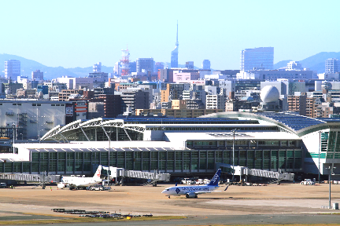
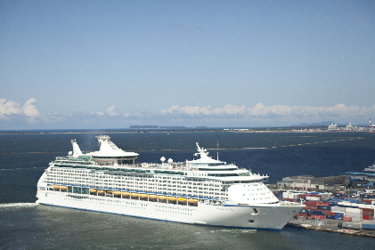
⑦
Environment
Fukuoka
International
Airport
International
Ferry Terminal

Slide 9
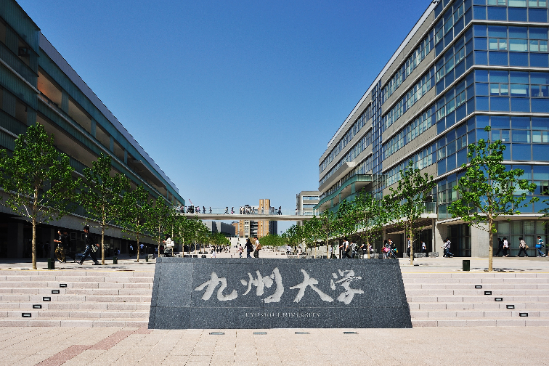
⑧
Education

Slide 10
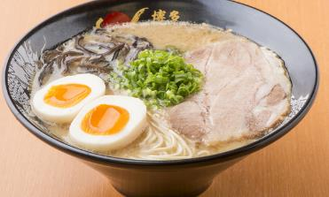
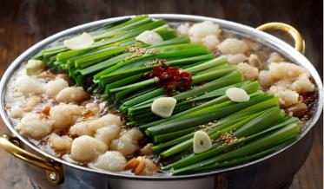
⑨
Culture (Food)
Ramen
Motsunabe
Mentaiko

Slide 11
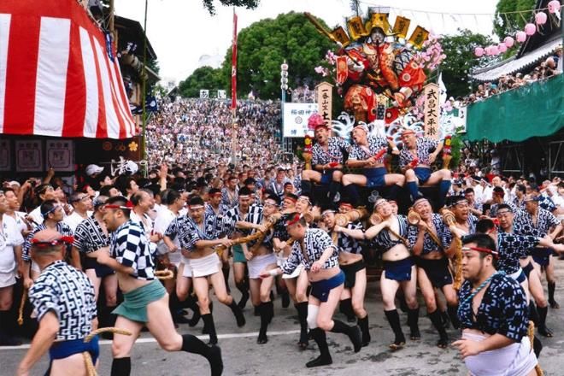
⑩
Culture (Festival)
Yamakasa (in July)

Slide 12
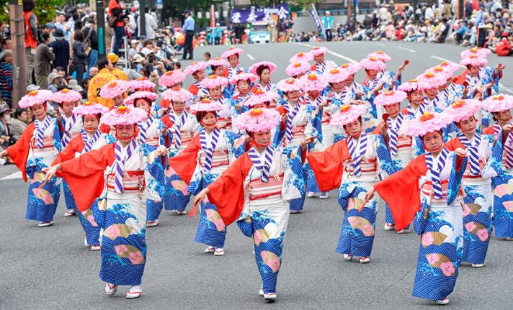
⑪
Culture (Festival)
Hakata Dontaku (in May)

Slide 13
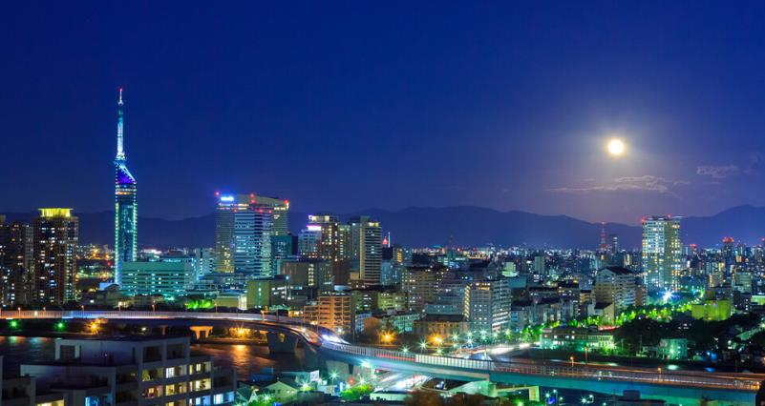
⑫
Please enjoy Fukuoka during your stay!!

